Slide 1

WEEK 8 PROGRESS REPORT
Airframe Team

Slide 2
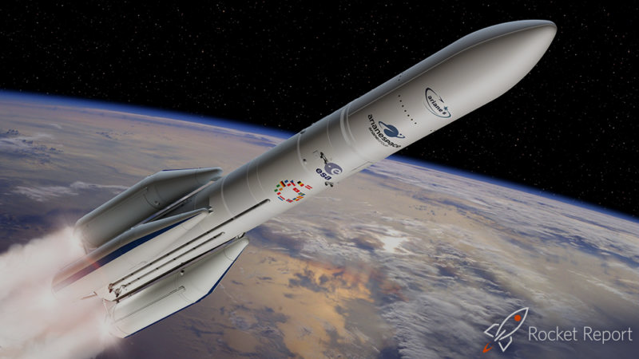
Objectives
Fabrication of the third airframe.
Creation of a 3D template with evenly spaced holes.
Fabrication of coupler for assembly between the airframe and motor casing in static test.
Preparation of AA1050 material for tensile testing.

Slide 3
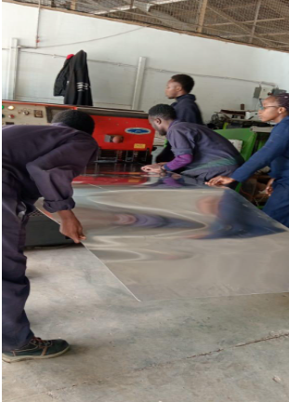
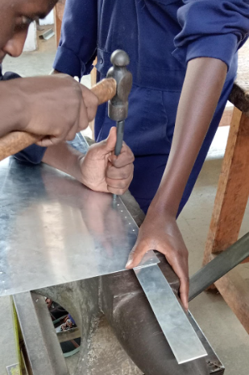
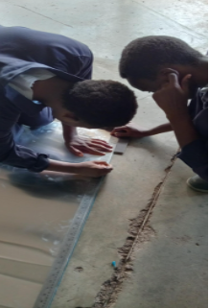
Fabrication of the third airframe.
Dimensions (Upper body tube): 850 mm length
Procedures
Marking the dimensions
Cutting by shearing machine
Marking points to be riveted

Slide 4
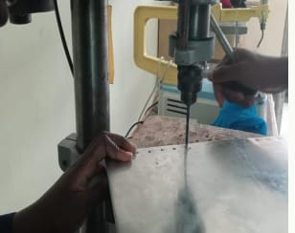
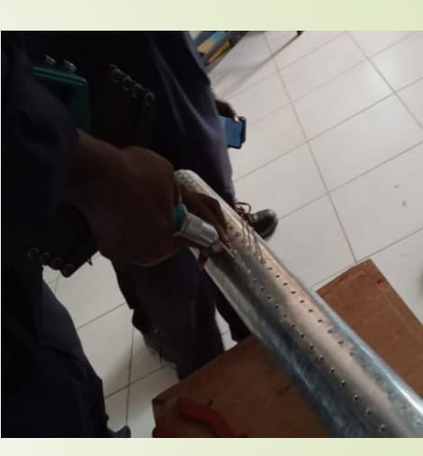
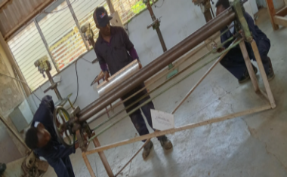
Fabrication of the third airframe.
Drilling using drilling machine
Rolling using plate rolling machine
Riveting with the rivet gun

Slide 5
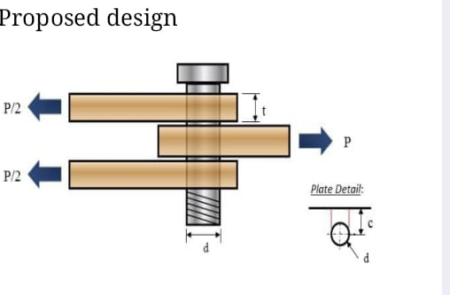
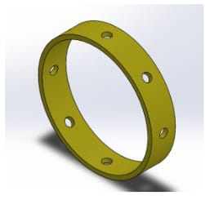
Creation of a 3D template with evenly spaced holes.
Design of faster assembly mechanism
Ensuring an airtight assembly and use of a single bolt cutting through the airframe,motor casing and nozzle.
It ensures accurate alignment of holes in the 3 parts.

Slide 6
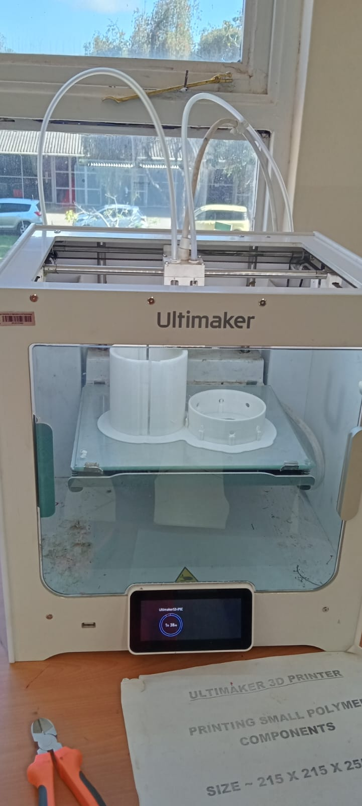
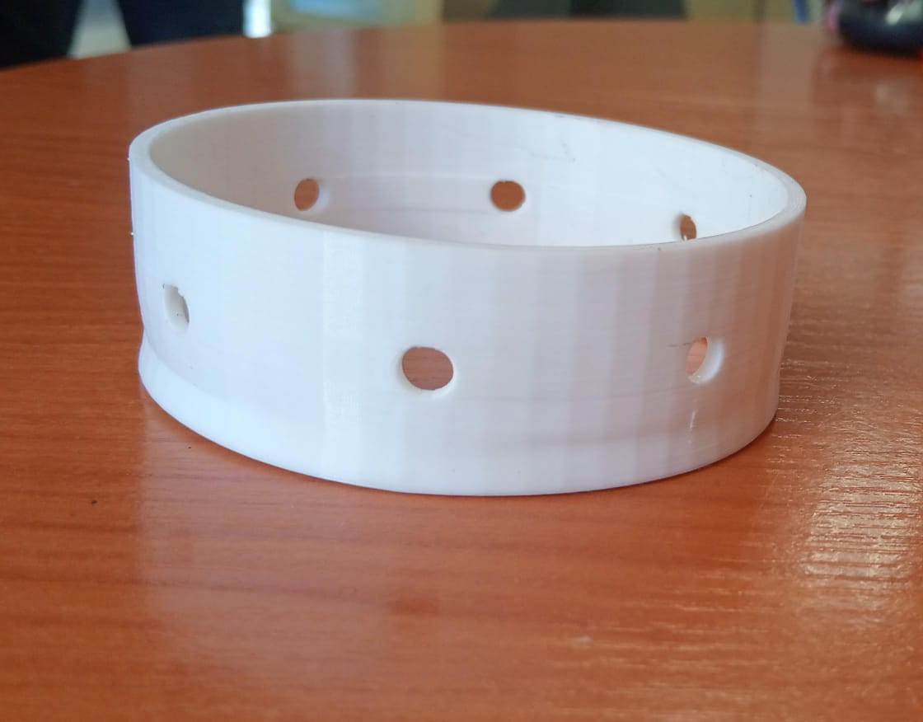
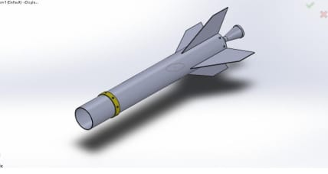
Creation of a 3D template with evenly spaced holes.
Procedure
Printing of the 3d template
Final product
Application

Slide 7
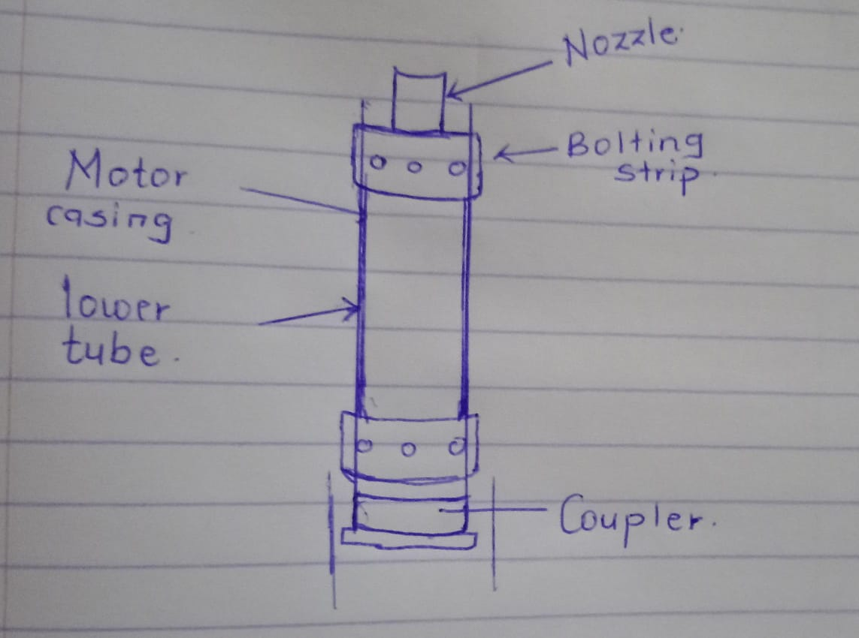
Fabrication of Coupler
Arrangement during static test
Purpose of the coupler
This prevents the airframe body from bending due to thrust of the motor

Slide 8
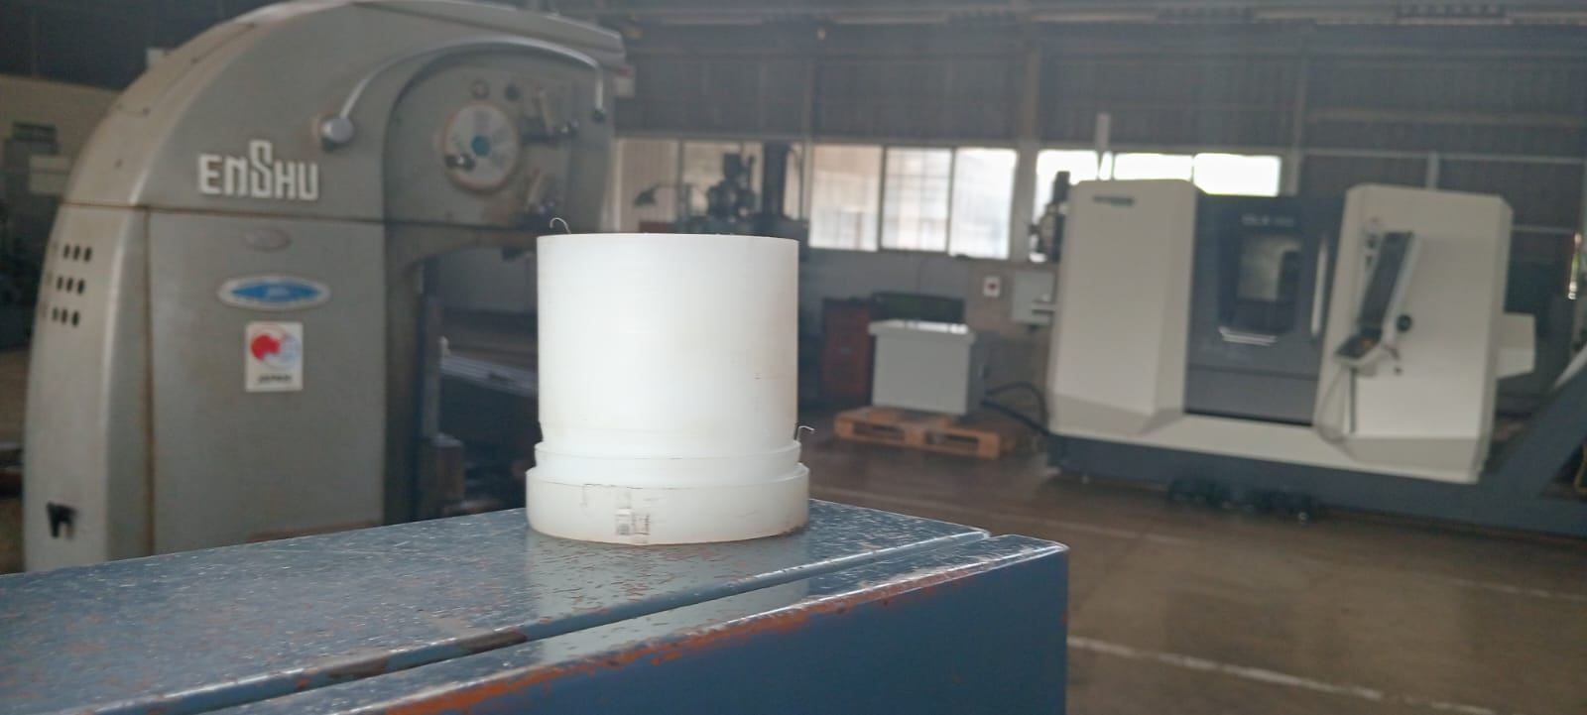
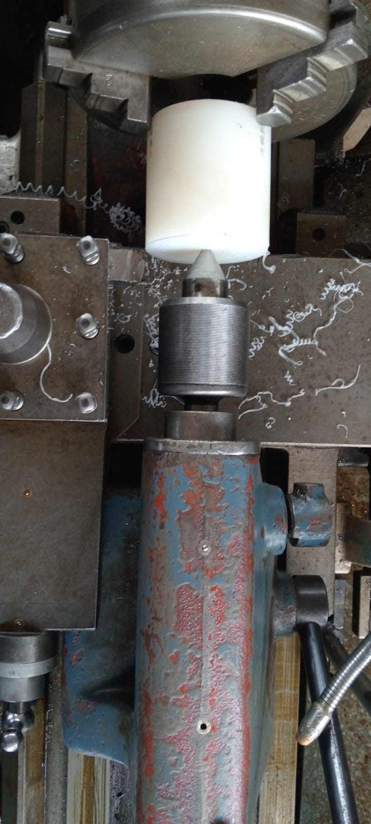
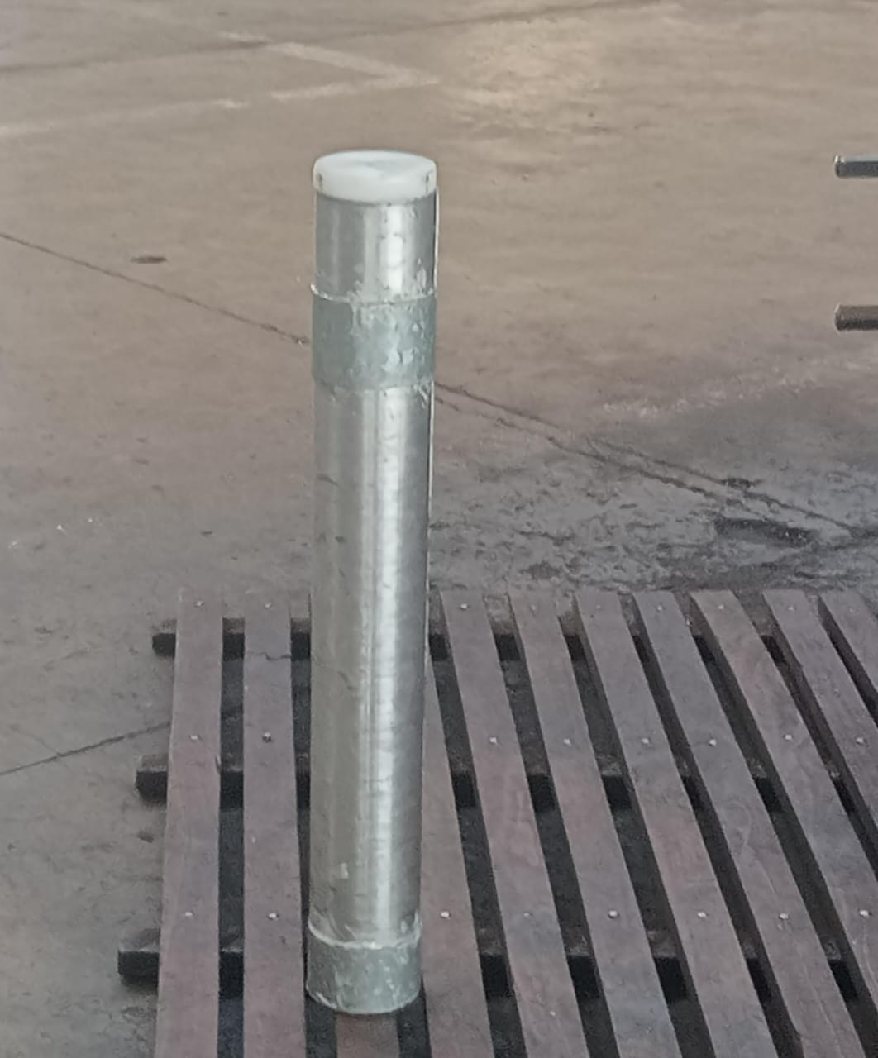
Fabrication of Coupler
Procedures
Facing and turning process
Final product
Assembly

Slide 9
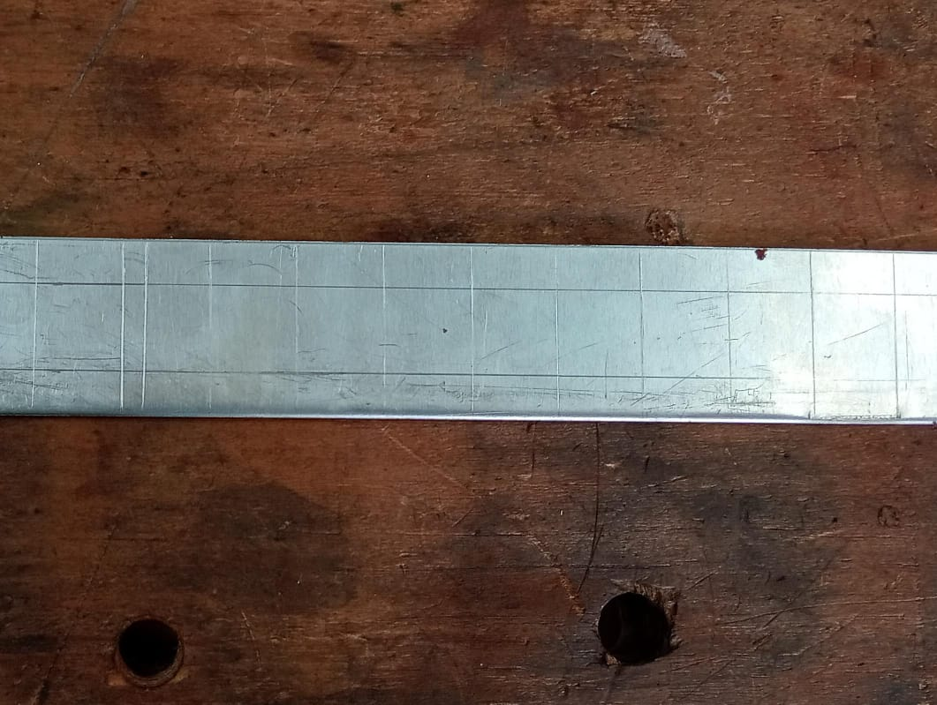
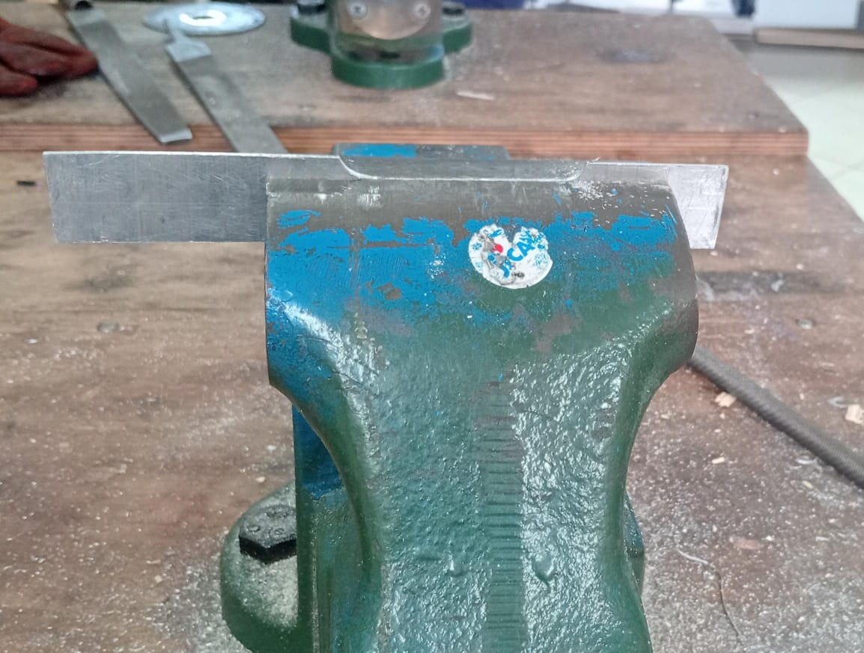
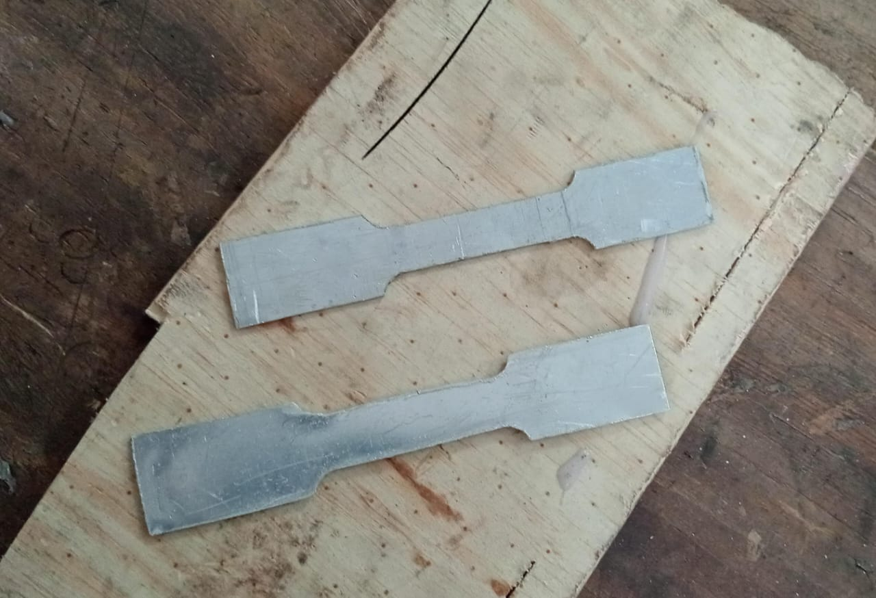
Preparation of AA1050 material for tensile testing
Preparation of the sample
Marking the required dimensions
Cutting and filing to the standard dimensions
Final products

Slide 10
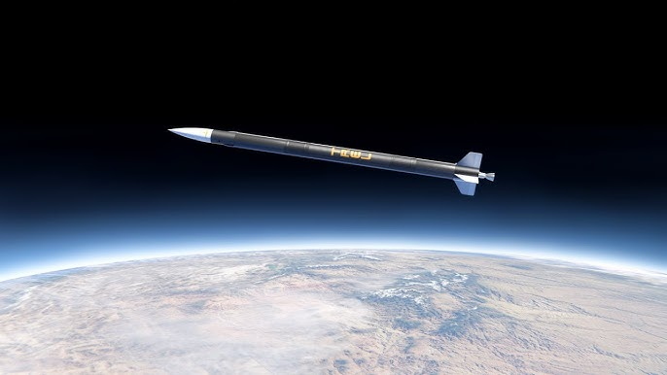
Remaining tasks
Proceed with fabrication of the next airframe
Perform static test with the solid propulsion team
Perform tensile test on the AA1050 material and compare it with material of the previous team.

Slide 11
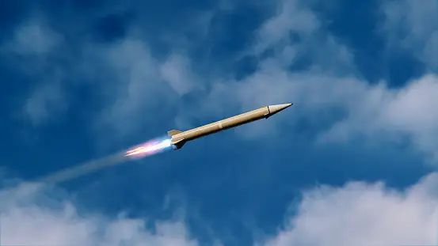
THANK YOU

